Slide 1
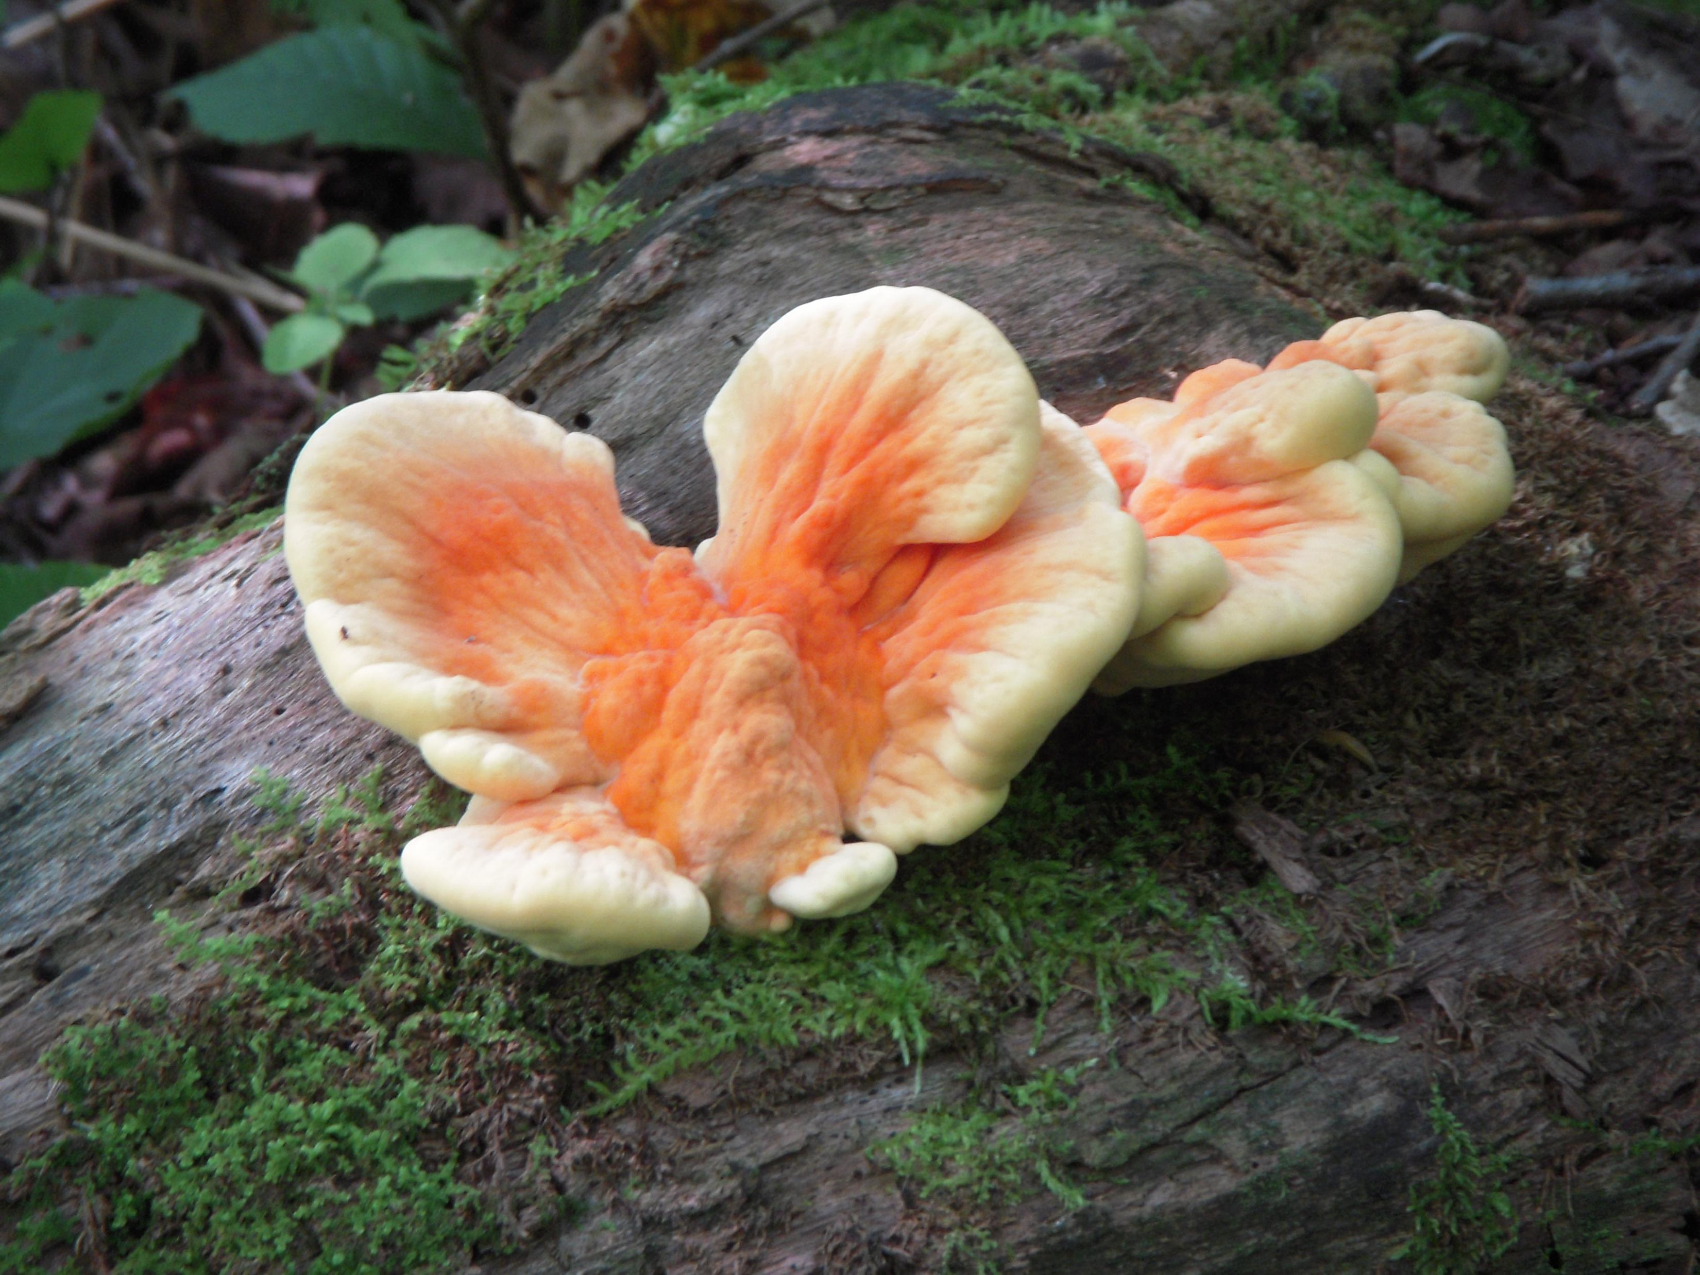
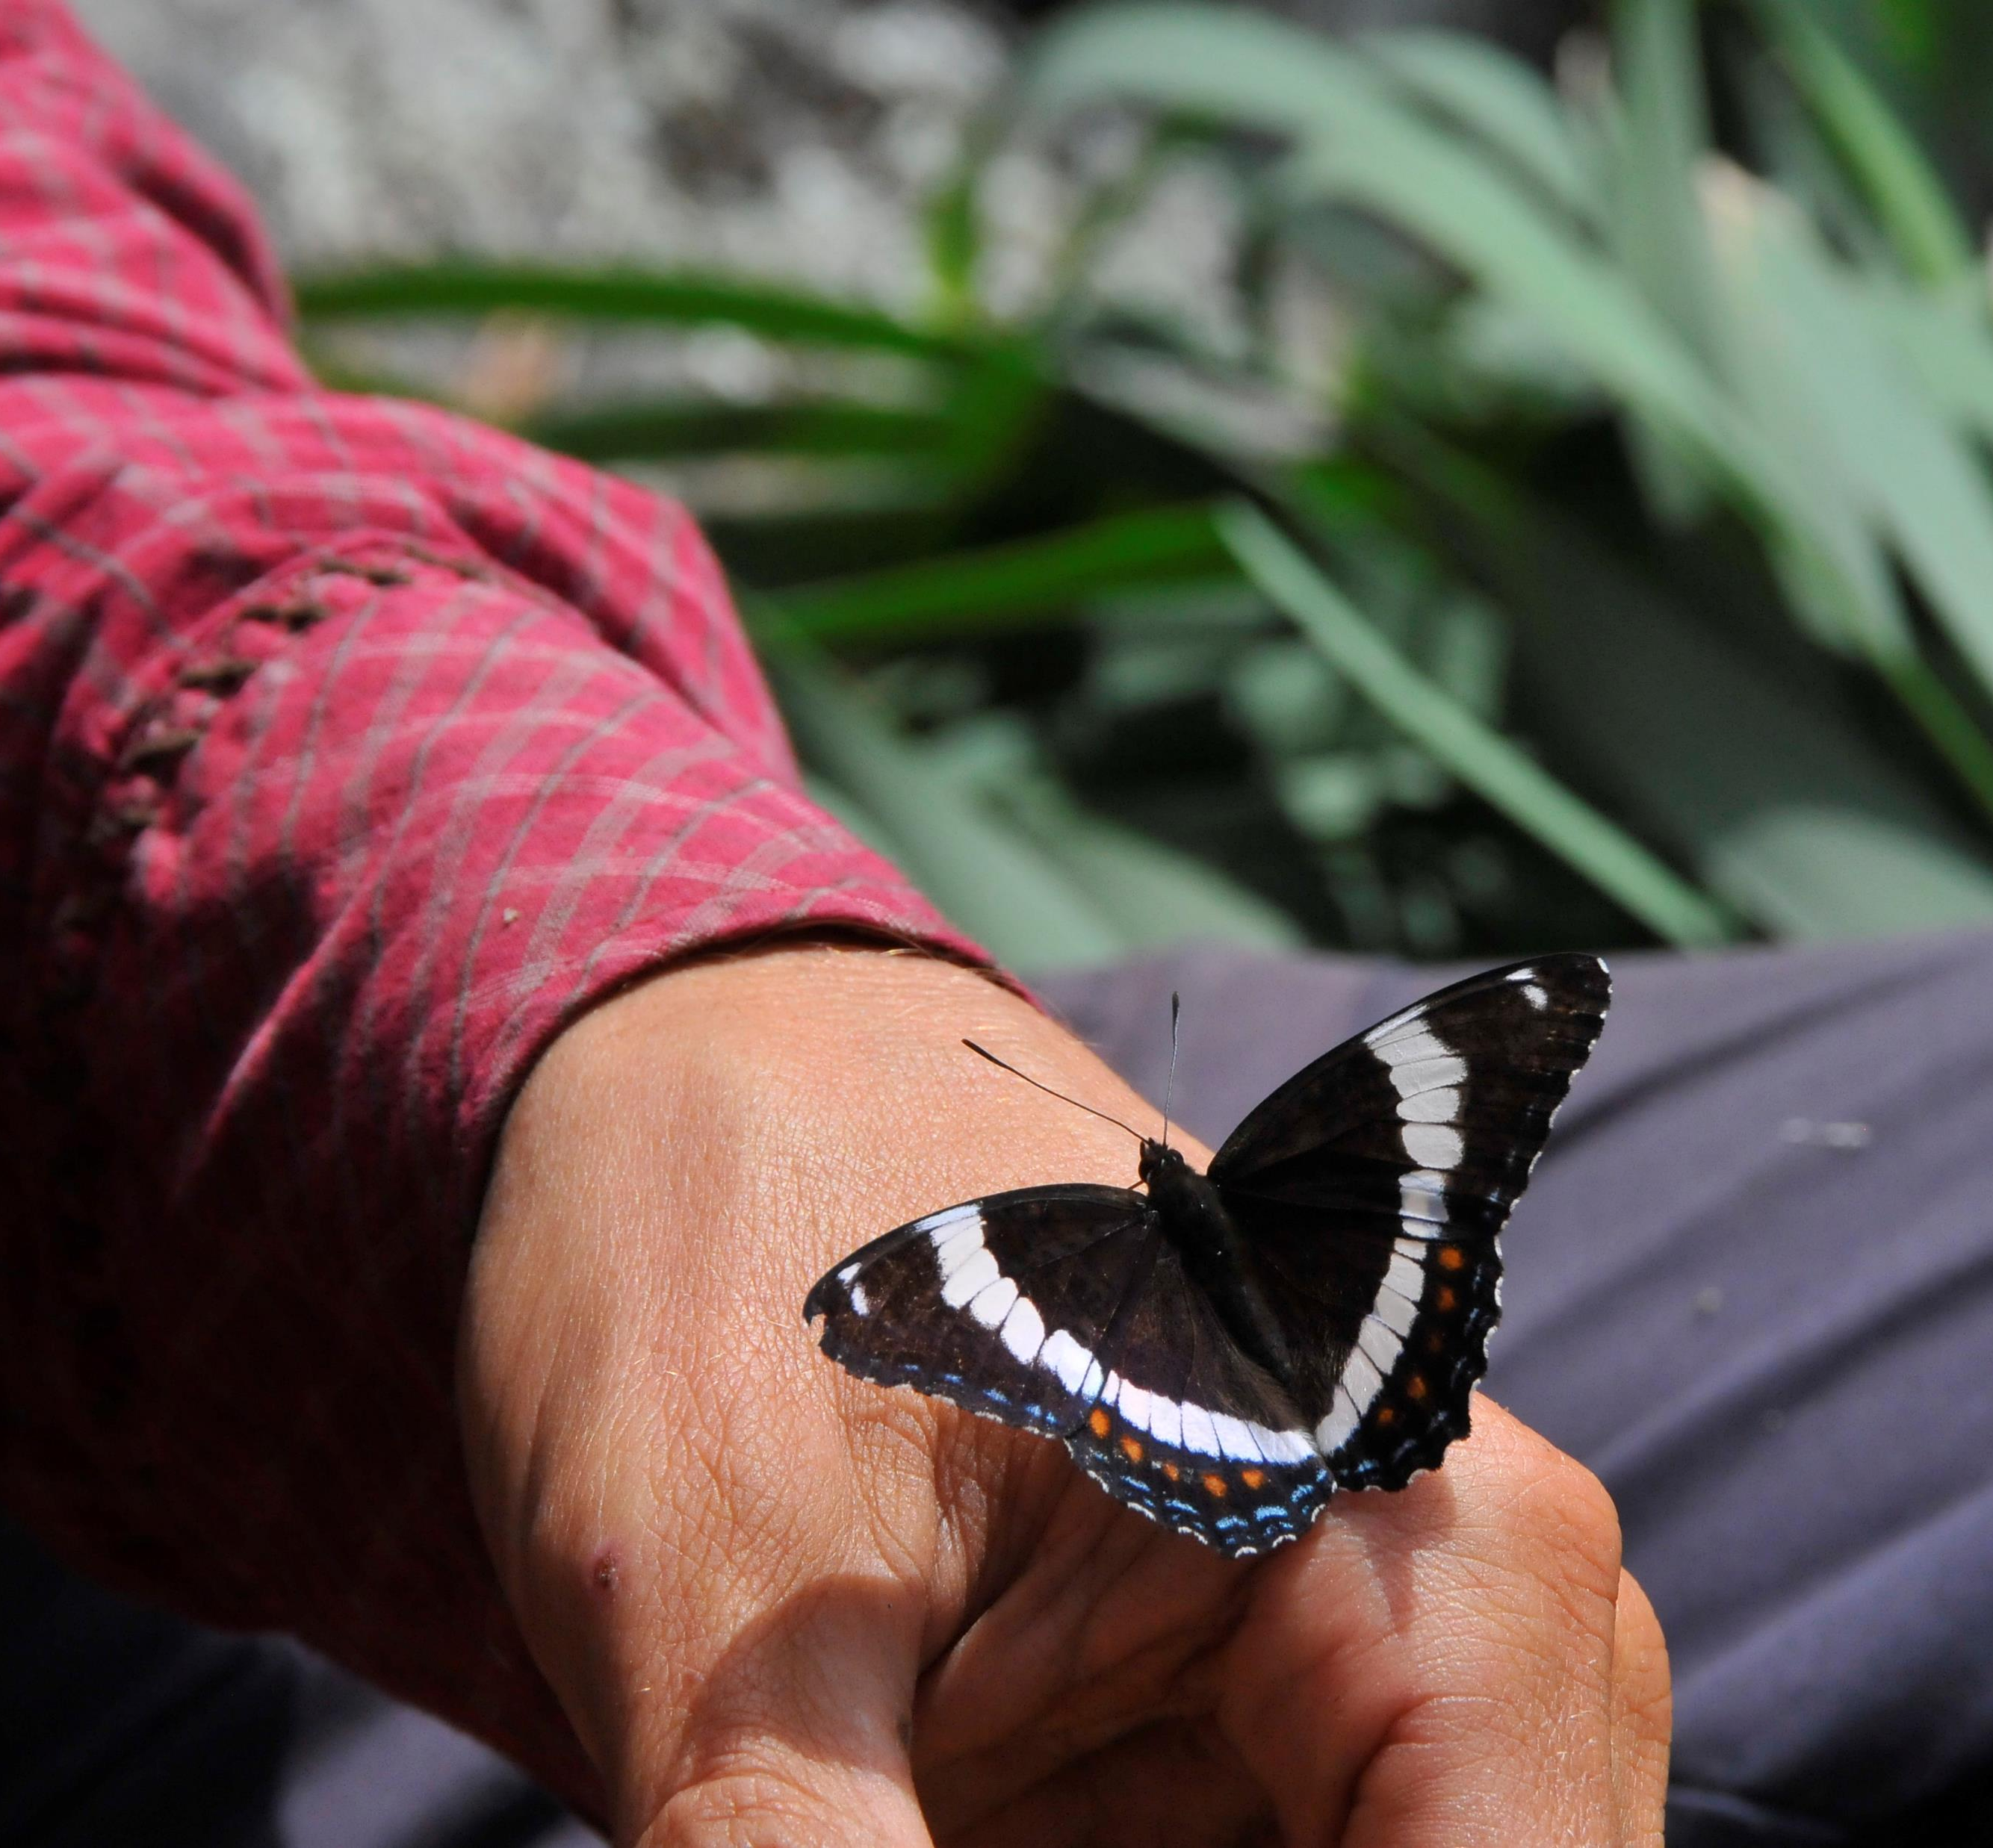
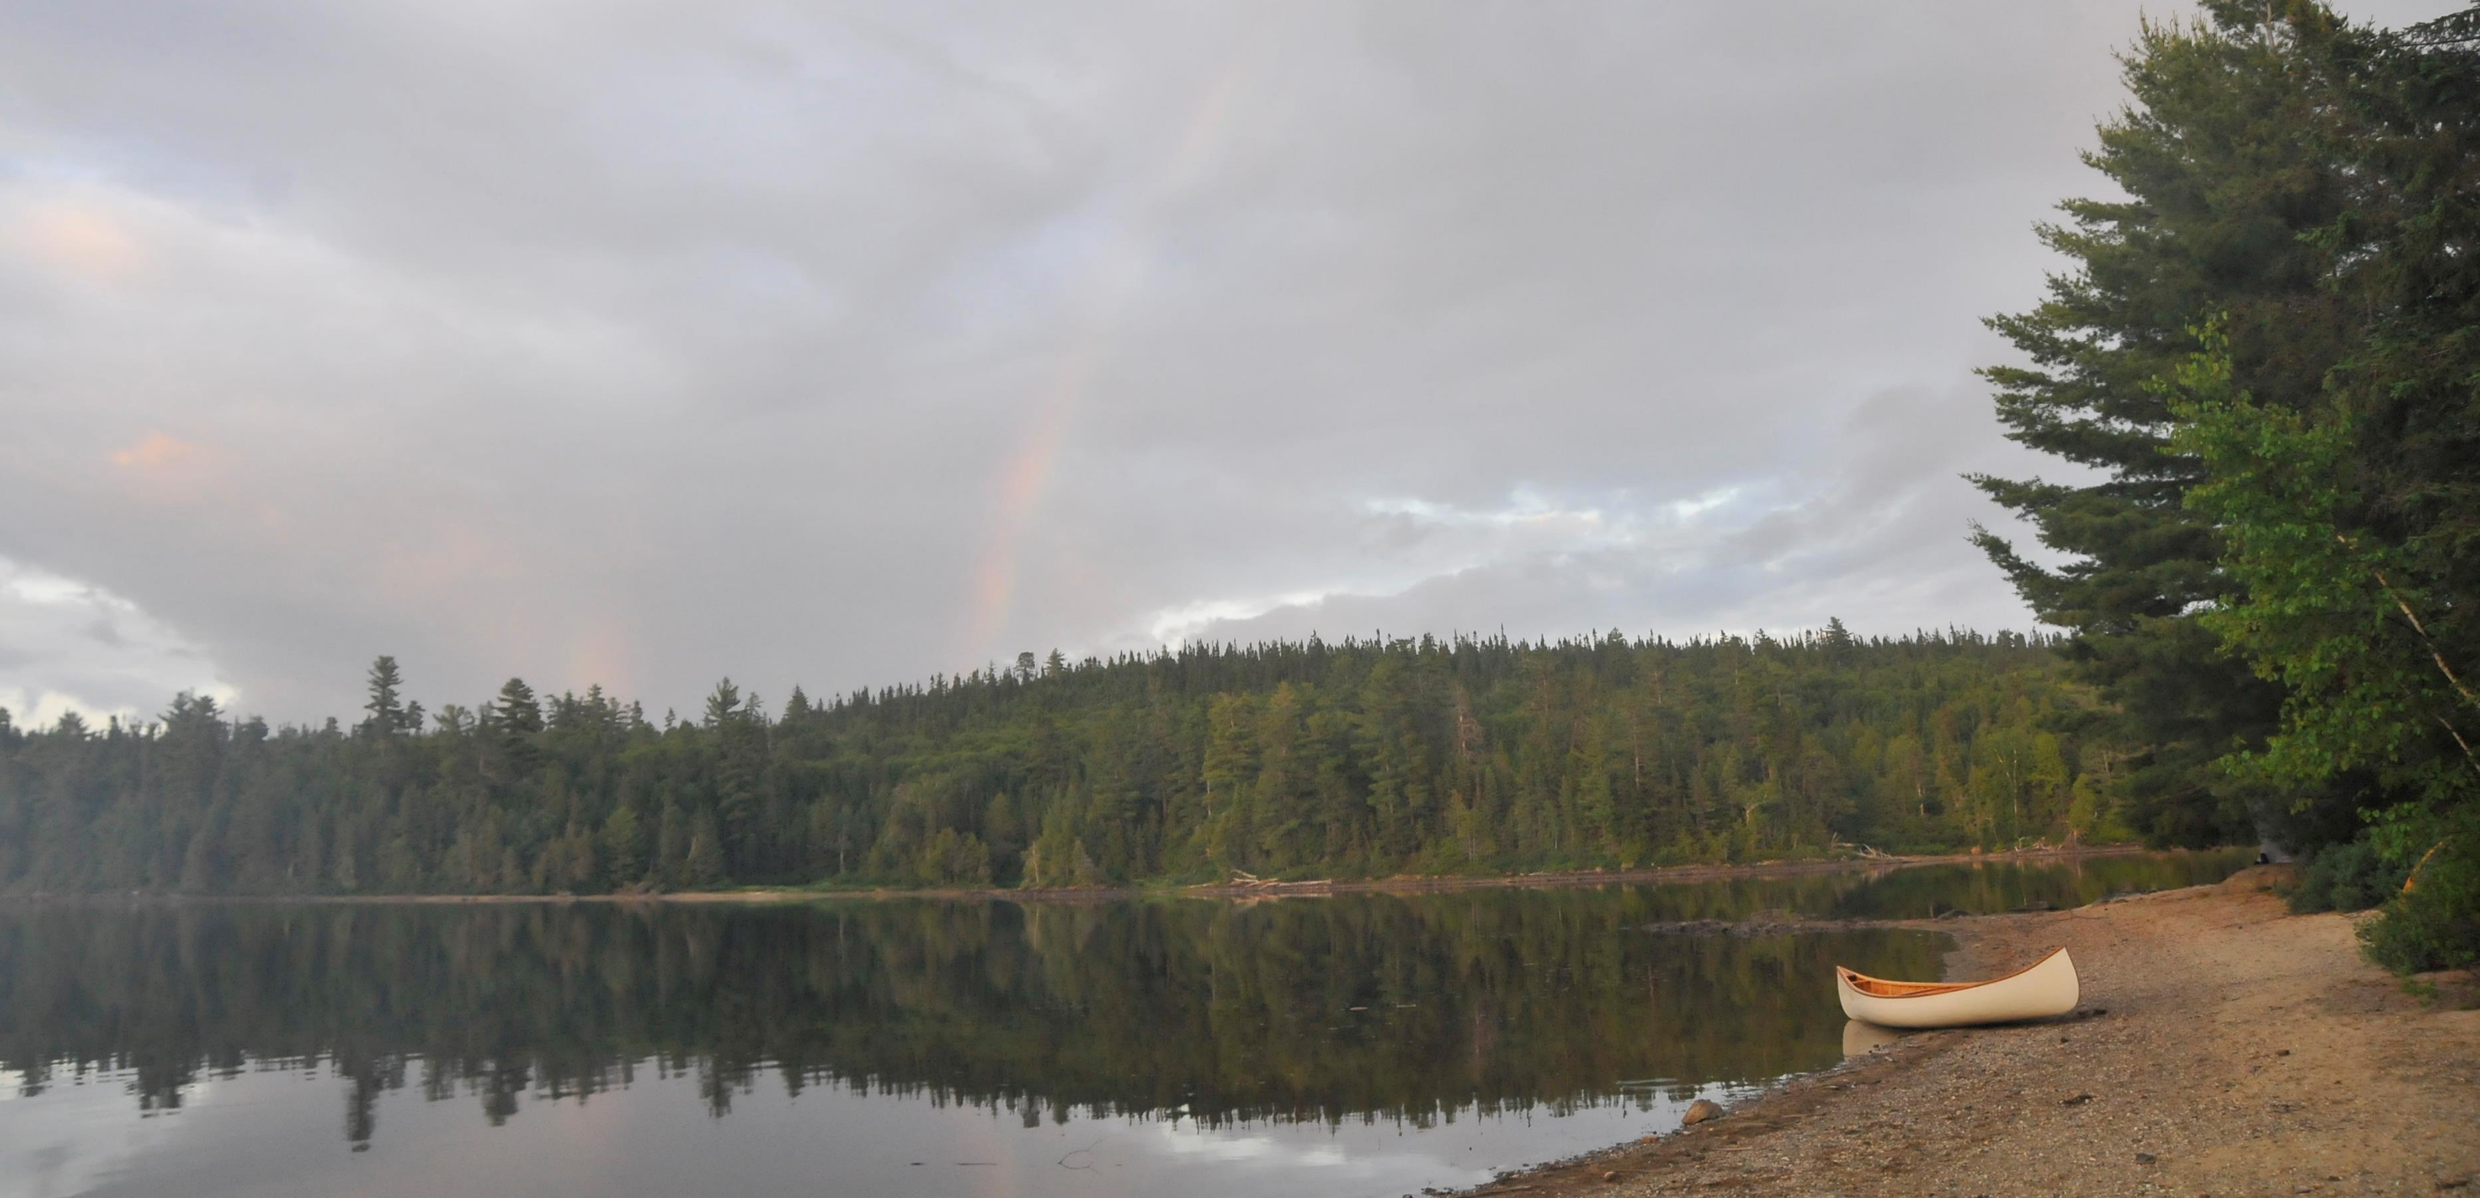
The Great Forest Protection March
The All Peoples Alliance for the protection of forests and 100 areas rich in natural biodiversity in southern Québec

Slide 2
Our life depends on biodiversity
Animals and plants that disappear as a result of human activity may provide the cure for a future disease or epidemic. And far beyond being economic resources, these species play an essential role in the fragile balance of nature. Deeply linked to everything living, our life depends on the richness of biodiversity.
.

Slide 3
Context
The Minister of Forests, Pierre Dufour, proposes to cut old growth forests to help fight climate change, without any scientific consensus
In his national strategy for wood production, he has plans to double the tree harvest in Quebec over the next 60 years.
The government has chosen to exclude nearly all of the territory where logging is feasible, when choosing protected areas to meet the international target of 17%, by December 2020.

Slide 4
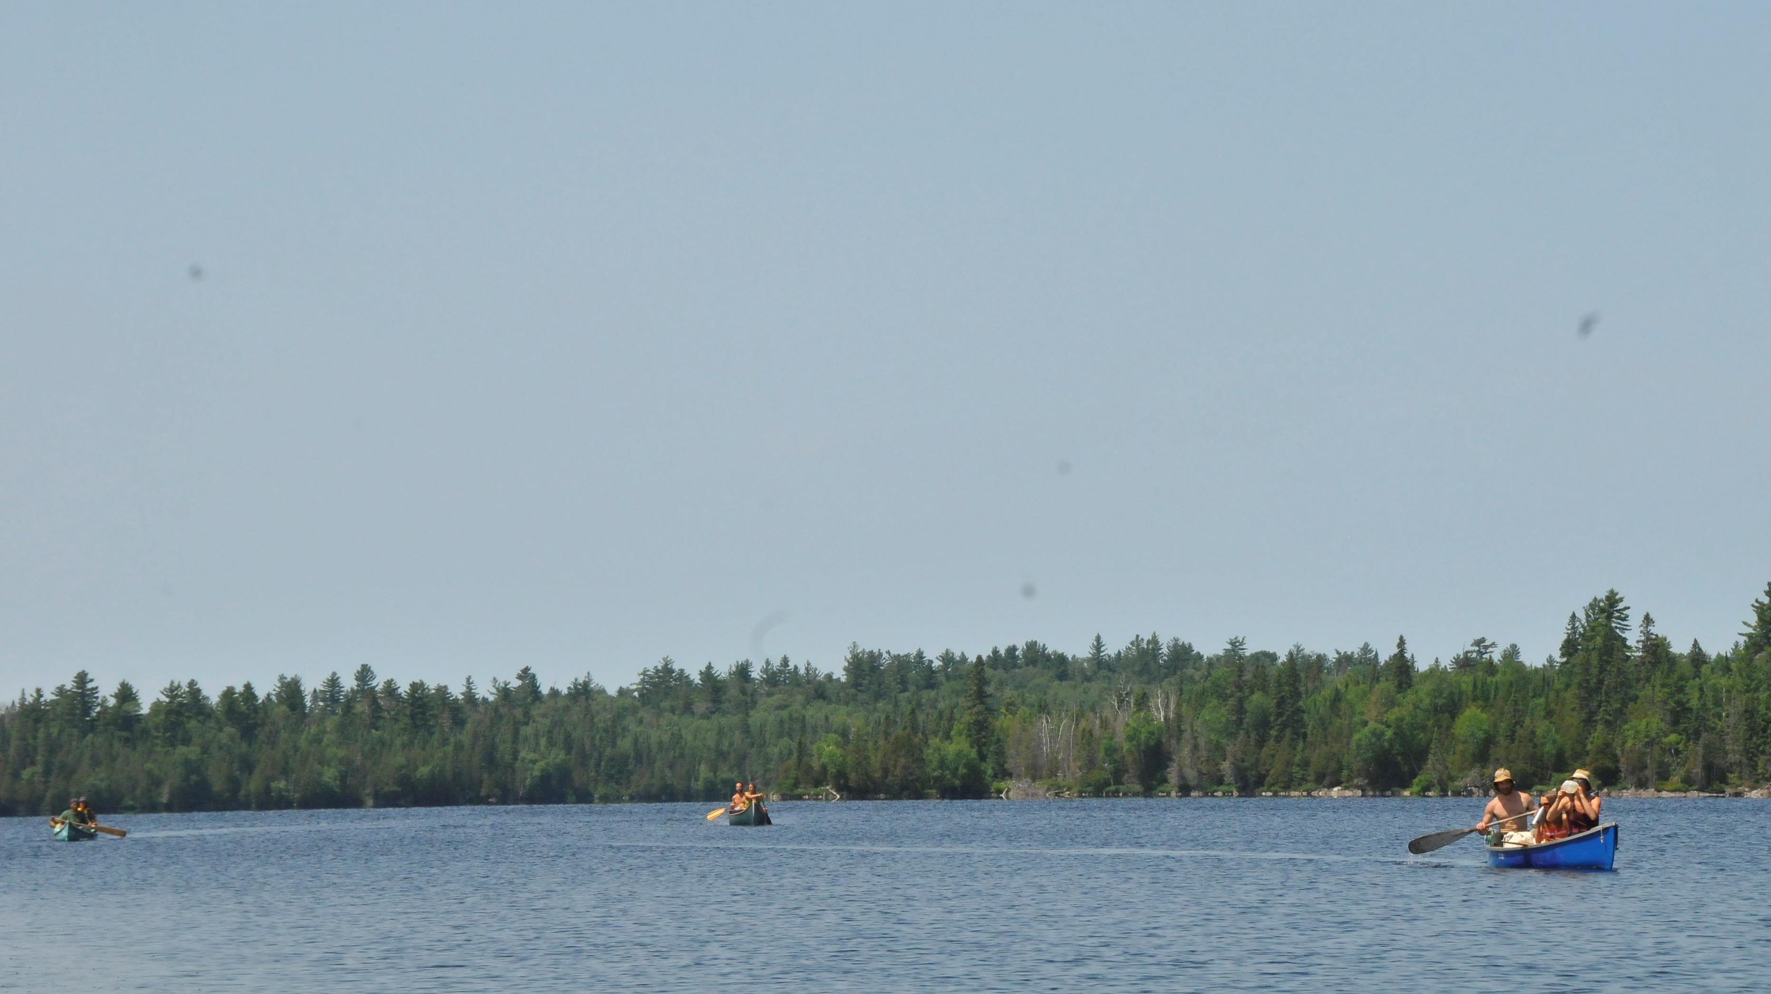
Extract from : The call to The Great Forest Protection March
The earth is our mother
The rivers are her arteries
The lakes her vital organs
The forest makes her breathe
Her heart beats at the same rate as ours:
Our bodies are a part of her body
We come from her loving womb
The earth is our mother
She also birthed all other life that surrounds us
She has always know how to heal us.
What’s worse, we’re hurting her, hurting the one who cares for us by abusing her kindness
To respect her, to respect her other children, our brothers and sisters, the plants, the other animals, water and air, we all have to come together and protect her
- Marie-Andrée Gill, poet
Pekuakamishkueu, Ilnu Mashteuiatsh

Slide 5
Intact forests, a vitally important solution for slowing climate change
“Here we argue that maintaining and, where possible, restoring the integrity of dwindling intact forests is an urgent priority for current global efforts to halt the ongoing biodiversity crisis, slow rapid climate change and achieve sustainability goals.
Retaining the integrity of intact forest ecosystems should be a central component of proactive global and national environmental strategies, alongside current efforts aimed at halting deforestation and promoting reforestation.”
-Watson et al, The exceptional value of intact forest ecosystems,
Nature, 2018

Slide 6
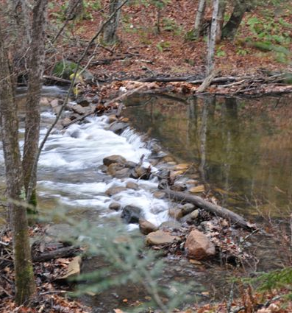
Water is life
Rivers are the veins through which all animal and plant life circulates and flourishes.
This is why it is essential to protect those rivers free of dams and / or those still full of magnificent wild life.
All rivers are precious. We have a responsibility to take care of those that are still healthy and to restore those that are polluted. Protect the rivers!

Slide 7
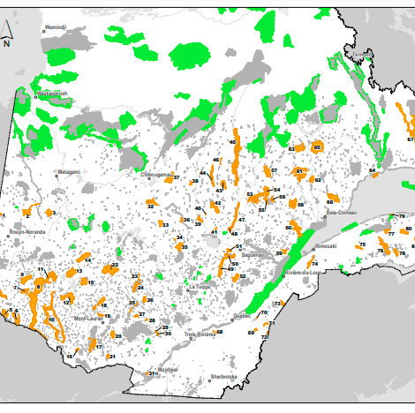
We have not protected the area where biodiversity is greatest.
The international commitment specifies that biodiversity must be maintained through an ecologically representative and well-connected network of protected areas …
The 83 protected area projects proposed by senior MELCC officials for southern Quebec, that make it possible to meet the agreement with the UN, were excluded in December 2020.
Protected areas located in the South are protected water and wetland areas, not included in the 17%

Slide 8
A long process of consultation, sometimes lasting more than 12 years, has just been completed
On the whole, citizens, scientists, local and regional elected officials, officials from all the ministries concerned, major environmental groups, First Nations communities, and even a number of forestry companies, had agreed on these 83 protected areas.
No one wants to go through this process again. All that's missing is a signature from the MELCC Minister. Public confidence in the government has been eroded following the decision to exclude these 83 natural areas from the protection project. Reaching the target of 30% protected areas will be a challenge in this context...

Slide 9
People everywhere are mobilizing to protect the lands they love with all their hearts

Slide 10
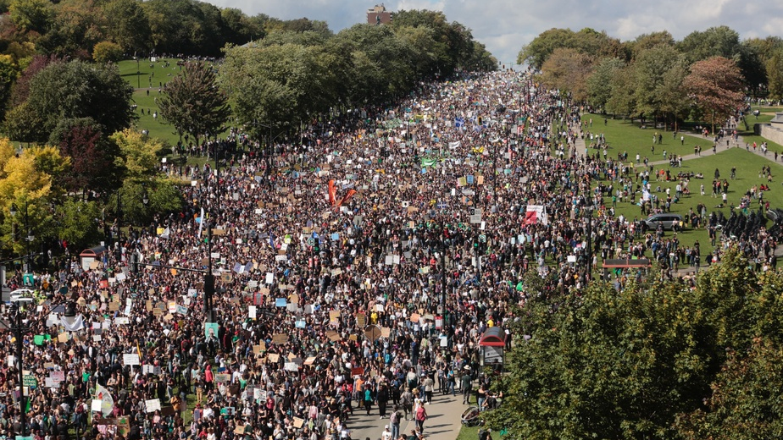
Now is the time to come together and to act together

Slide 11
A Great March uniting people from all communities and nations
Marchers will set out from the 4 directions of the province and converge on Quebec City on October 16th, 2021.

Slide 12
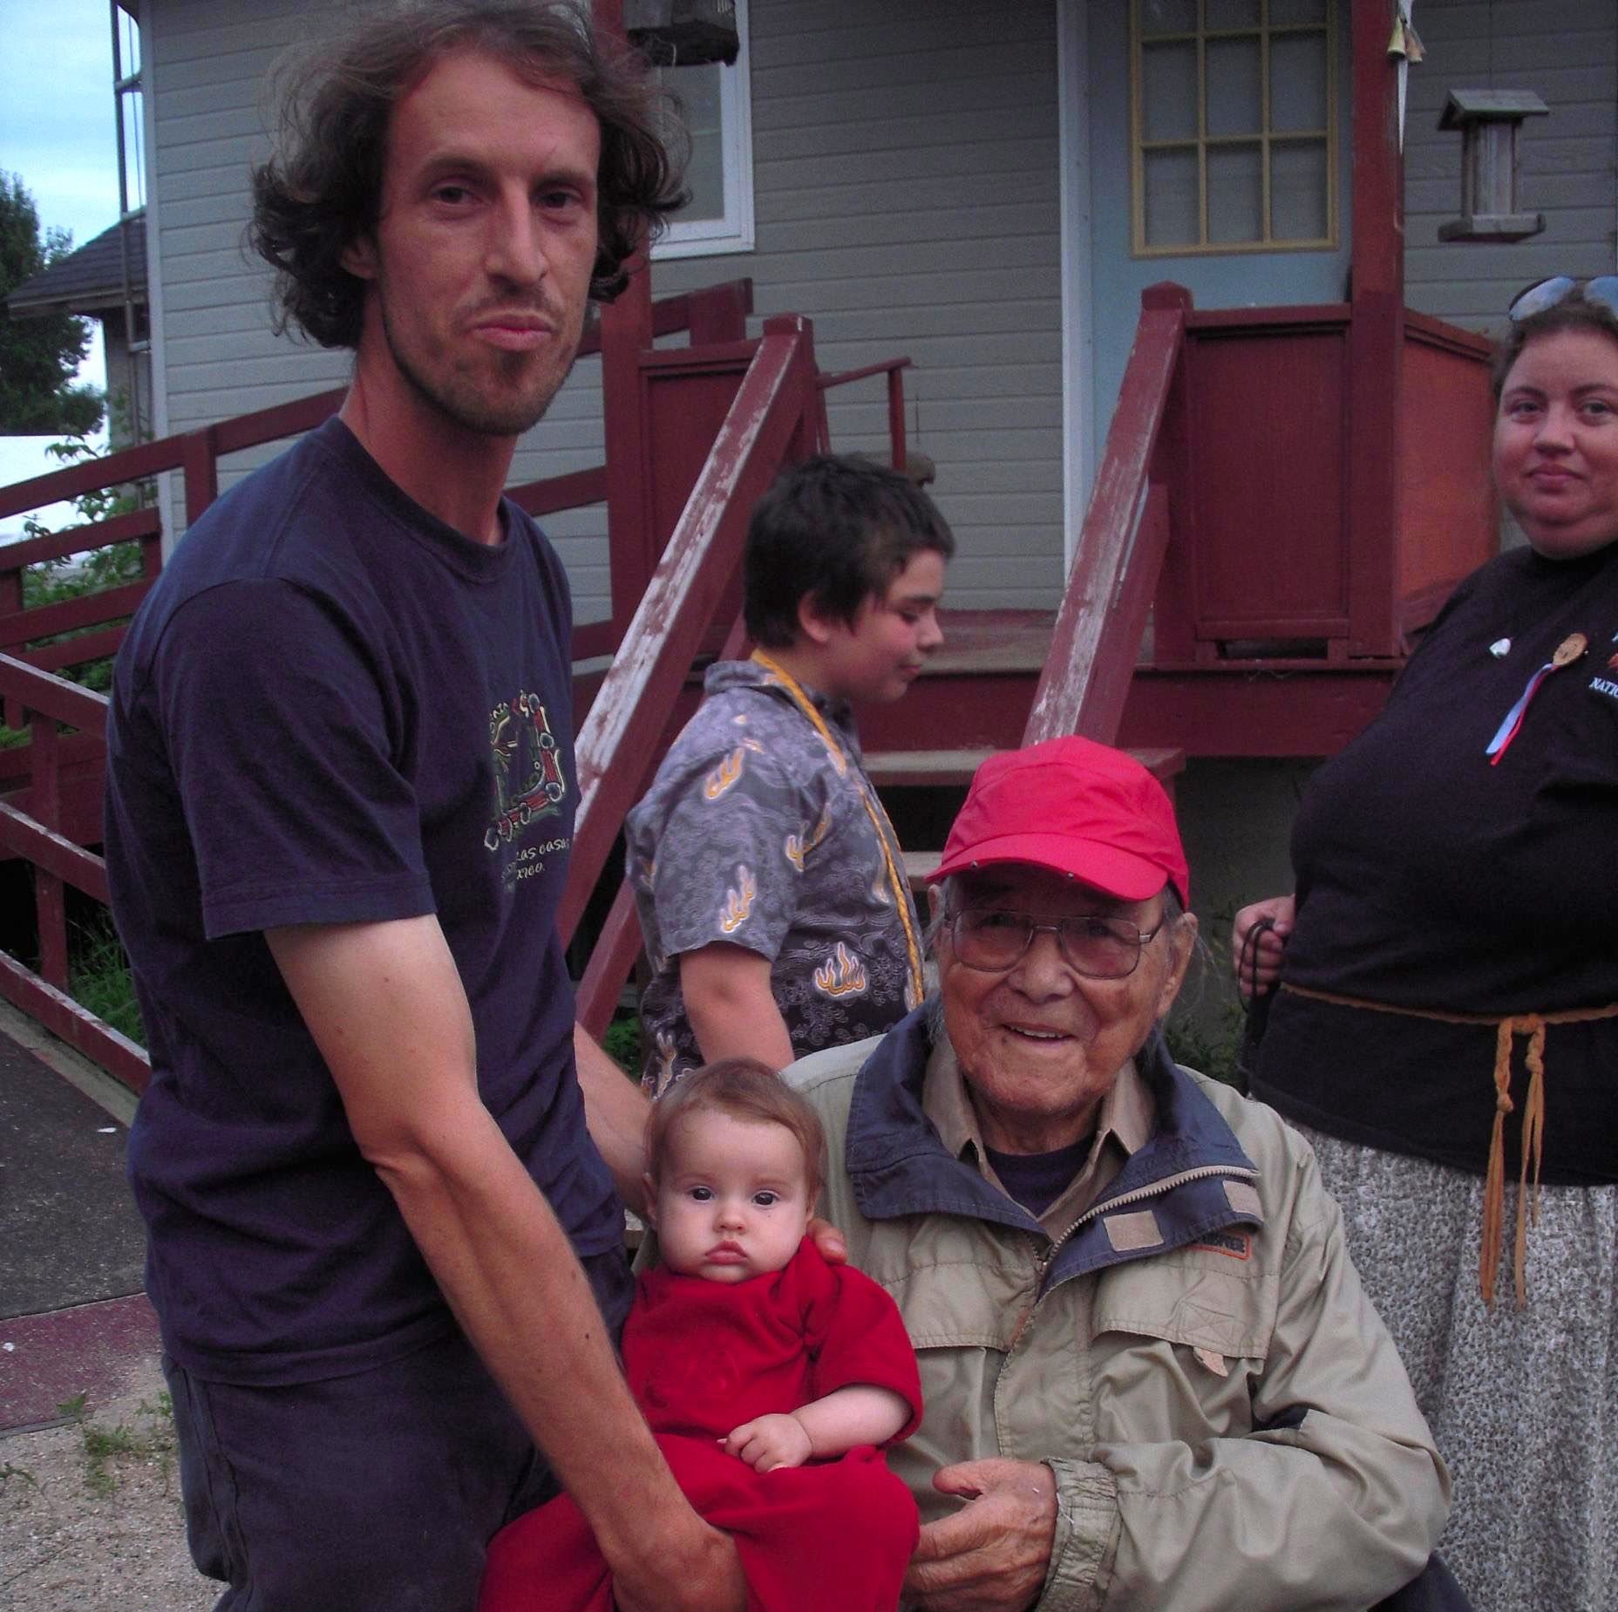
Listening to
the First Peoples
One of the main purposes of this action is to bring people together in all their diversity (native-non-native, women, men, people who self-identify differently, elders and young people).
This march will honour the work and life of William Commanda, a Great Anishinabe Teacher who dedicated his life to the protection of Mother Earth and the unification of Peoples, as well as all the elders who have shared and worked for the same vision.

Slide 13
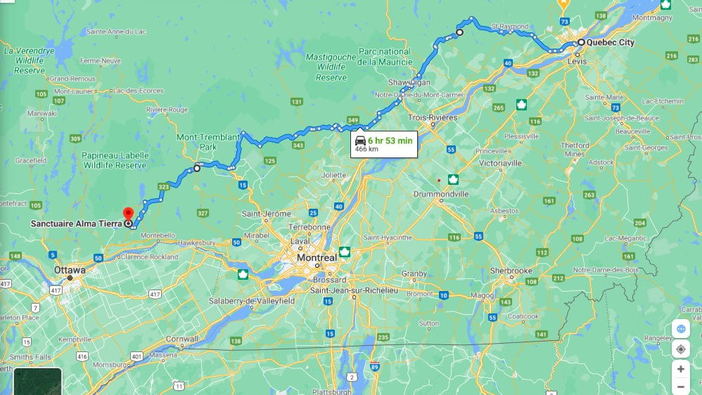
On the path of humility and empathy
(The nobodies who share and care)
Some small groups will travel far, (more than a month on the road) and along the way, they will meet with many people and gather their visions for a world that supports and respects biodiversity.

Slide 14
Listening to the youth and to nature
Children's drawings, representing endangered plant and animal species, will be given to the marchers. Also, the youth will have the chance to have their environmental concerns heard and taken into account…especially on the subject of biodiversity.
All this through the educational project Toi mon espèce Rare, (You My Rare Species) finalist for the PRIX DEMAIN ! Le Québec from the David Suzuki Foundation.

Slide 15
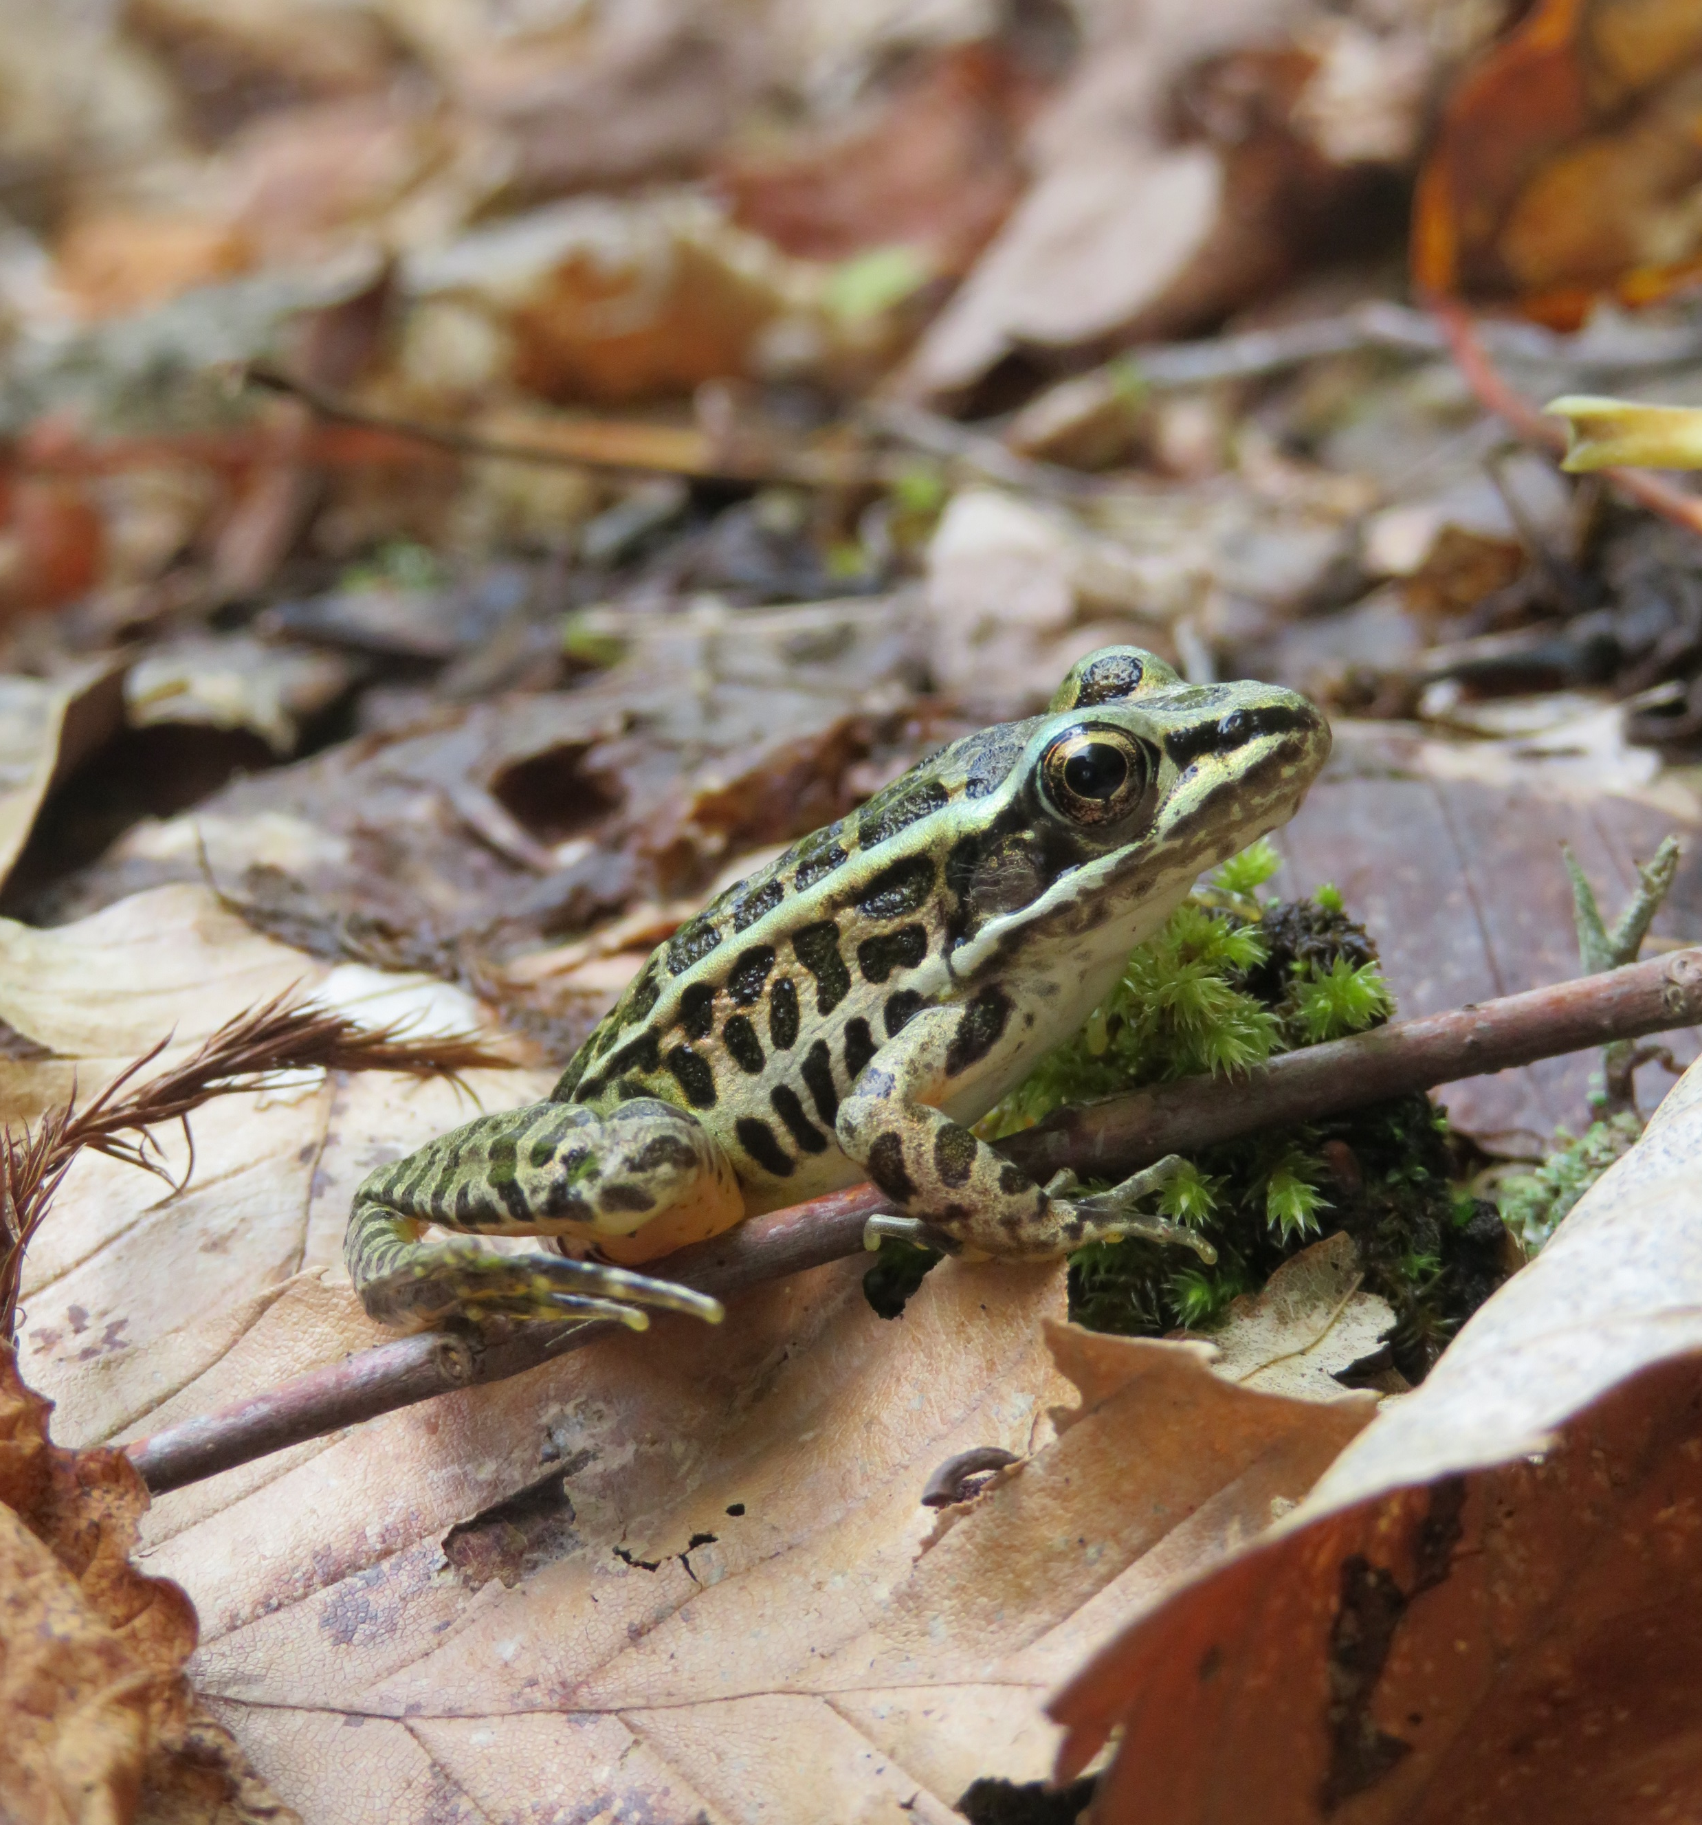
Together we share one planet
The final destination will host a mass gathering on the last day of the Great March in which all the organizations and citizens wishing to add their voices for the protection of the land can join.

Slide 16
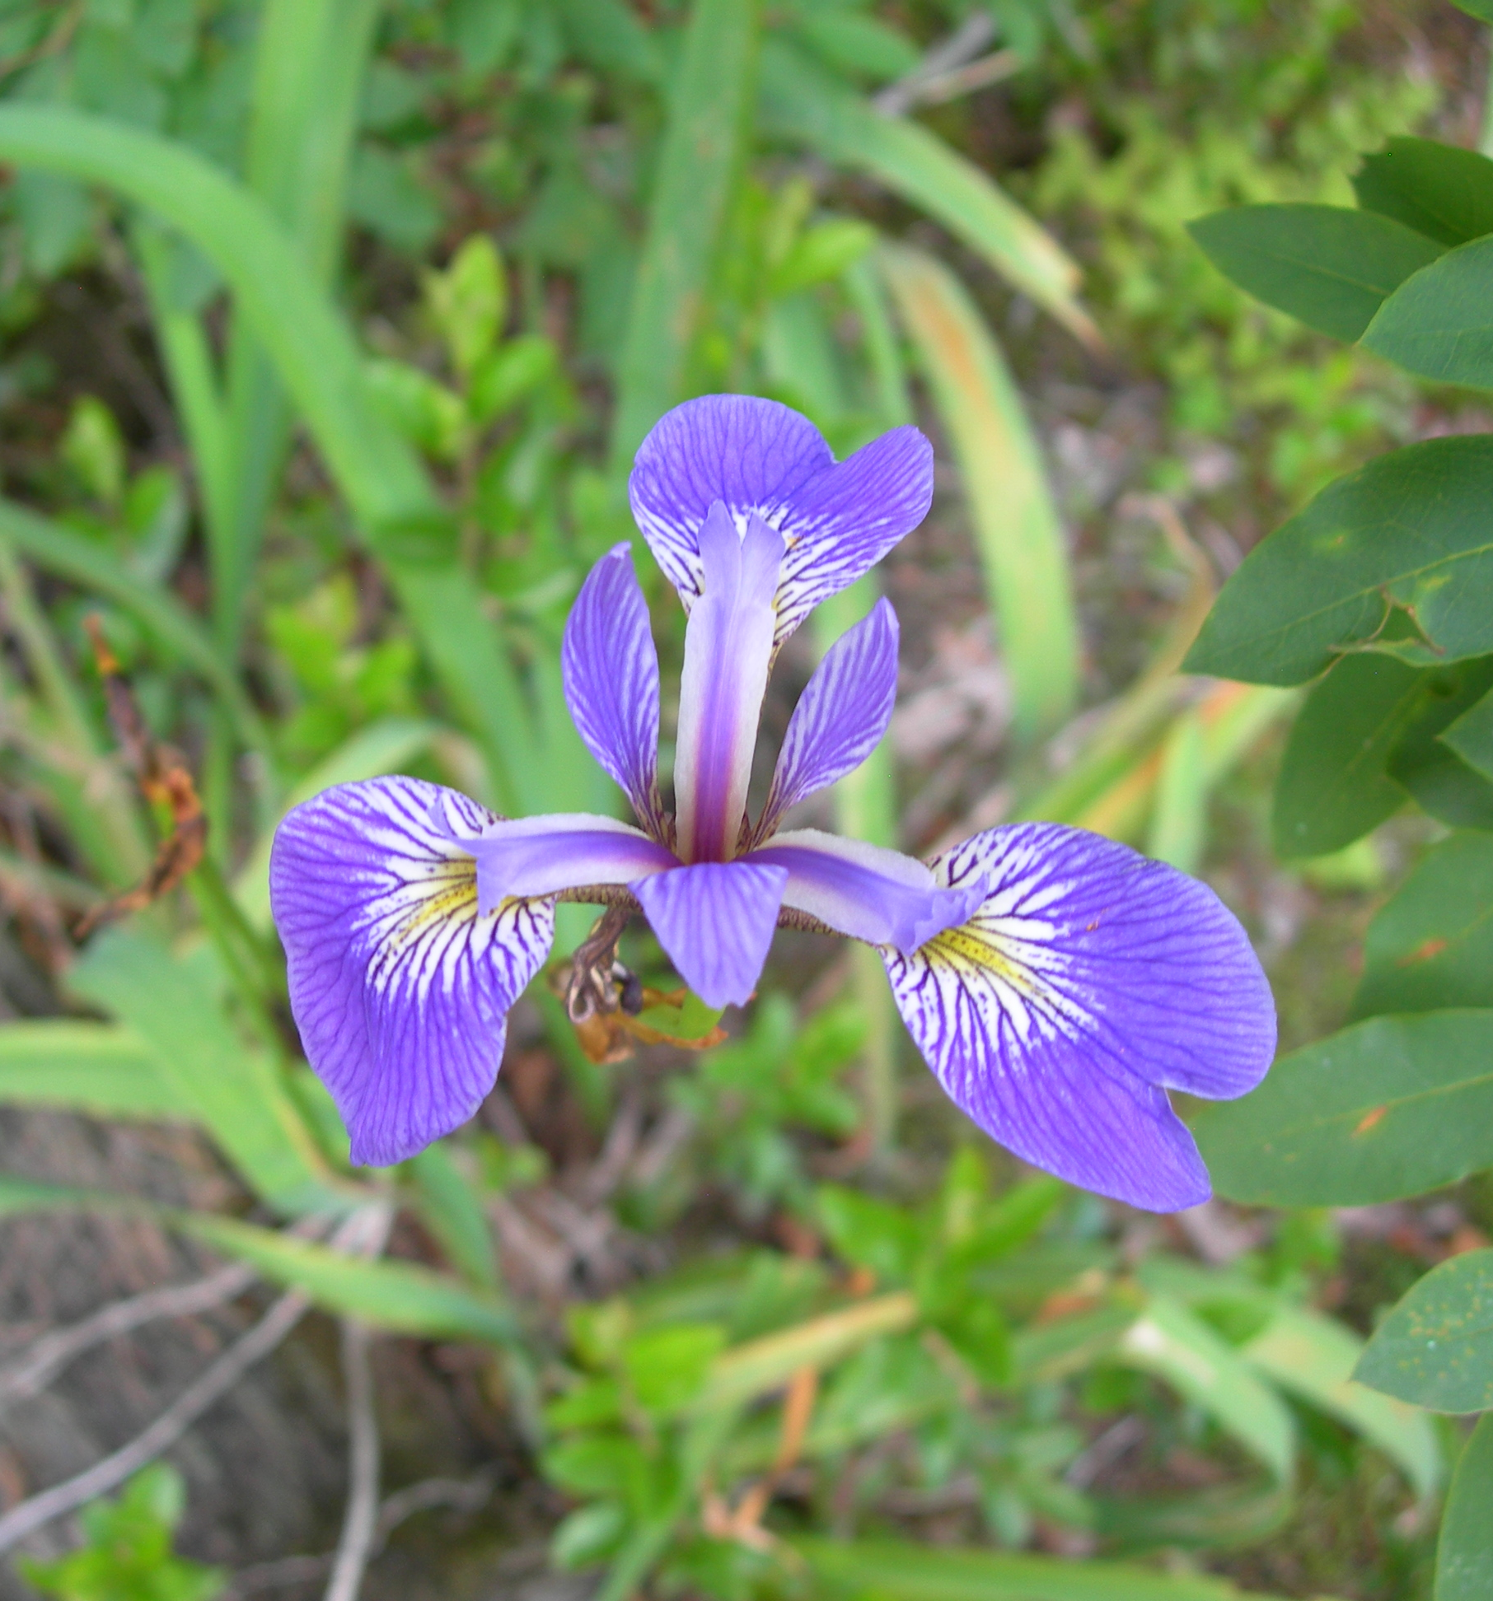
We can all stand up together and take a step in the same direction Together for the land
Artists, spokespersons (non-native and native) and elected officials will gather to deliver a common message. Their collective demand and their banner of drawings will be hand delivered to the National Assembly. Elected officials will be invited to listen to the message.

Slide 17
The demands we are making
La protection des 100 projets d’aires protégées prioritaires dans le Sud du Québec en terres publiques;
The 80 biodiversity reserve projects submitted by the MELCC and the M.R.C., municipalities, community organizations, aboriginal communities, citizens and scientists to the government.
Protected area projects initiated by specific indigenous communities
Protected area projects led by local communities with strong popular support.
Support the creation of an independent scientific institution for forest management including indigenous science.
Soutenir la protection de l’ensemble des boisés urbains et périurbains au niveau municipal et provincial au Québec. Proposition de la création d’une loi facilitant la création d’aires protégées en milieux densément peuplés.
Modify the law on forests to include, in a "concrete" way, the thoroughly thought out conservation of biodiversity throughout the forest territory.

Slide 18
How you can get involved
Getting the word out (helping with the mass publicity effort)
Mobilize environmental stakeholders
Participate in logistics (planning & organizing)
Join the march starting from your area and organize a march from your area - register on the March website or Facebook page
Suggest the class project to your local school and day camp (can be found on the website www.lagrandemarche.ca)
Register on the website www.lagrandemarche.ca and the Grande Marche Facebook page
Raise awareness among politicians in your area - use the descriptive material located on our web page
Prepare creative, educational, connected and heartfelt actions for this fall
Create connections with the people around you on this issue and share information
Make a donation on our GofundMe page

